Slide 1

Department of Computer Science and Engineering
Cotton Crop Disease Detection
Batch Members: 2320030286 – V Krishna (Team Leader) 2320030329 – Anmol Nayak 2320030431 – Akshath Reddy | Domain Deep Learning Under the Guidance of Ramya V, Assoc.Prof.

Slide 2

Abstract
Problem: Crop diseases (like bacterial blight and wilt) severely threaten cotton yields, requiring fast and accurate detection.
Solution: We developed an automated deep learning system for cotton disease classification using Transfer Learning.
Methodology: Comparative study using modern pre-trained CNNs (ConvNeXt-Tiny, RegNet, Xception) fine-tuned on the cotton disease dataset.
Key Result: The ConvNeXt-Tiny model achieved 100% test accuracy, demonstrating superior performance in instantly classifying the four major categories.
Future Vision: Deploying the model for real-time, field-level disease severity estimation to guide precision farming.

Slide 3
Introduction
Global Impact of Cotton: Cotton is a crucial cash crop, essential for the global textile industry and farmer income.
Threat of Disease: Bacterial Blight, Curl Virus, and Fusarium Wilt are primary threats, causing significant yield and quality loss (estimated 6-12% globally).
Limitations of Traditional Methods: Manual visual inspection is time-consuming, prone to human error, and impractical for large fields.
The Rise of Deep Learning: Convolutional Neural Networks (CNNs) offer a scalable and highly accurate solution for pattern recognition in crop images.
Project Goal: To create a robust, deep learning-based diagnostic system for quick and precise identification of cotton leaf diseases in the field.

Slide 4
Literature Survey
Research and Application of Cotton Crop Disease Detection and
Recognition Based on Deep Learning
Zhang et al.
2023,
TheTransfer Learning Validation: Several studies (e.g., Islam et al., Tao et al.) confirm that Transfer Learning using pre-trained models (like Xception, VGG-19) significantly improves cotton disease detection accuracy (up to 98.7%) with less training data.
Advancement to ConvNeXt: Recent research by Tao et al. specifically demonstrated ConvNeXt's superiority in cotton disease detection, achieving up to 100% accuracy by combining CNN efficiency with Transformer architecture advantages.
Identified Gap (Our Focus): Existing high-accuracy classification systems often lack real-time deployment capability and, critically, the ability to quantify disease severity—a major requirement for precision fungicide application (as highlighted by various agricultural reports).

Slide 5
Objectives
Comparative Study: Implement and compare multiple advanced deep learning models (ConvNeXt, RegNet, Xception) for cotton disease classification.
Achieve High Accuracy: Fine-tune the chosen model (ConvNeXt) using Transfer Learning and data augmentation to achieve classification accuracy above .
Disease Categorization: Accurately classify the four key states: Healthy, Bacterial Blight, Curl Virus, and Fusarium Wilt.
Model Optimization: Select the model offering the best balance of accuracy and computational efficiency for future deployment.
Develop a Pipeline: Establish a clear, end-to-end data processing and prediction pipeline ready for real-world integration (e.g., in a mobile app)

Slide 6
Problem Statement
Inaccurate Diagnosis: Farmers struggle to visually distinguish between different diseases, leading to incorrect treatment and wasted resources.
Late Detection: By the time diseases are identified manually, they are often too widespread to control effectively.
Lack of Quantification: Existing methods only classify the disease type, but fail to quantify the percentage of crop damage (severity).
Economic Loss: This delay and misdiagnosis result in significant financial losses for farmers and impacts the national cotton yield.
The Solution Gap: The current industry needs an intelligent, automated system that not only identifies what the disease is but also how much impact it has, enabling precise, targeted treatment.

Slide 7
Existing System
Manual Inspection: Relying on human experts, agricultural field officers, or the farmer's own experience for visual diagnosis.
Laboratory Analysis: Expensive and time-consuming process involving taking samples from the field to a specialized lab for confirmation.
Traditional Image Processing: Older systems used features like color and texture extraction (SVM/KNN classifiers), which were unreliable under varying light/field conditions.
Standard CNN Classifiers (Baseline): Many existing AI prototypes use older CNNs (like ResNet-50 or VGG-16) that are less efficient and can be computationally heavy for mobile deployment.
Absence of Severity Metrics: Most published classification models do not provide the vital disease severity percentage required for precision agriculture applications (e.g., dosing fungicide).

Slide 8
Proposed System
Modern Architecture: We propose using ConvNeXt-Tiny—a novel, efficient, and highly accurate model—for rapid disease classification.
Transfer Learning: Utilizes the knowledge from the massive ImageNet dataset to achieve high accuracy ( on our selected dataset) with optimized training time.
Future Enhancement (The Unique Pivot): Integrate the final classification model into an Object Detection/Segmentation framework (like a modified YOLO or U-Net) to automatically locate the disease spots and calculate the affected leaf area (i.e., Disease Severity).

Slide 9
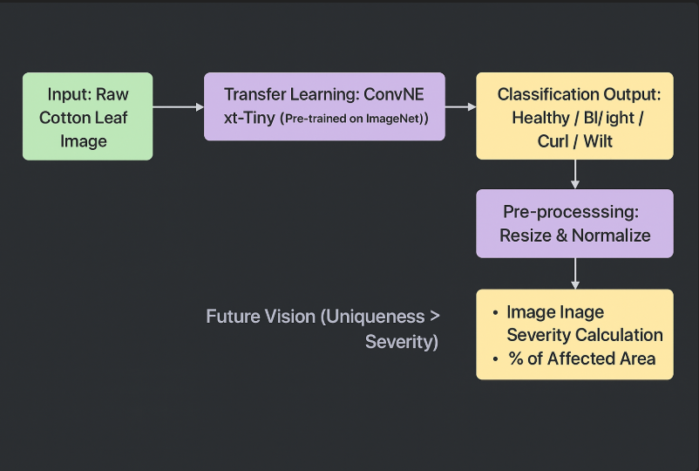
Block Diagram of Proposed System
Fig no.: Fig. Name

Slide 10
List of Modules
Data Acquisition: Collecting and organizing the raw cotton leaf images into distinct disease classes.
Data Pre-processing: Standardizing images (Resizing to ) and applying image normalization.
Data Augmentation: Techniques (like rotation, shifting, zooming) used on the training set to prevent overfitting and improve generalization.
Transfer Learning Module: Loading weights from the pre-trained ConvNeXt-Tiny model.
Model Adaptation (Fine-Tuning): Replacing the final fully connected layer to match the 4 disease classes.
Training Module: Executing the learning process using the Adam optimizer and Cross-Entropy loss over 10 epochs.
Validation Module: Monitoring model performance on a separate validation set during training to detect overfitting.
Prediction Module: Generating classification probability scores on unseen test images.
Evaluation Metrics: Calculation of Accuracy, Precision, Recall, and F1-Score for robust performance analysis.
Visualization Module: Generation of Accuracy/Loss plots and the Confusion Matrix.

Slide 11
Details about the tools to be used for the project implementation
Deep Learning Framework: PyTorch (Used for ConvNeXt and RegNet implementation) / TensorFlow (Used for Xception implementation - Show flexibility).
Programming Language & Libraries: Python (core language) with specific libraries: torchvision, scikit-learn, matplotlib, and seaborn.

Slide 12
Module Explanation
Data Acquisition: Collecting and organizing the raw cotton leaf images into distinct disease classes for training. Data Pre-processing: Standardizing image size () and normalizing pixel values to suit the model input. Data Augmentation: Artificially expanding the training dataset to improve model generalization and prevent overfitting. Transfer Learning Module: Utilizing pre-trained ConvNeXt weights to leverage prior knowledge from massive public datasets (ImageNet). Model Adaptation (Fine-Tuning): Adjusting the final classification layer to specifically output predictions for the 4 cotton disease classes. Training Module: Executing the deep learning process using the Adam optimizer to efficiently minimize the classification error (Loss). Validation Module: Periodically testing the model on unseen data during training to monitor performance and detect when overfitting begins. Prediction Module: Taking a new image as input and outputting a probability distribution over the four possible disease classes. Evaluation Metrics: Calculating key metrics like Accuracy, Precision, and F1-Score to demonstrate model reliability. Visualization Module: Generating visual reports (like the Confusion Matrix and Loss plots) for transparent performance analysis.

Slide 13
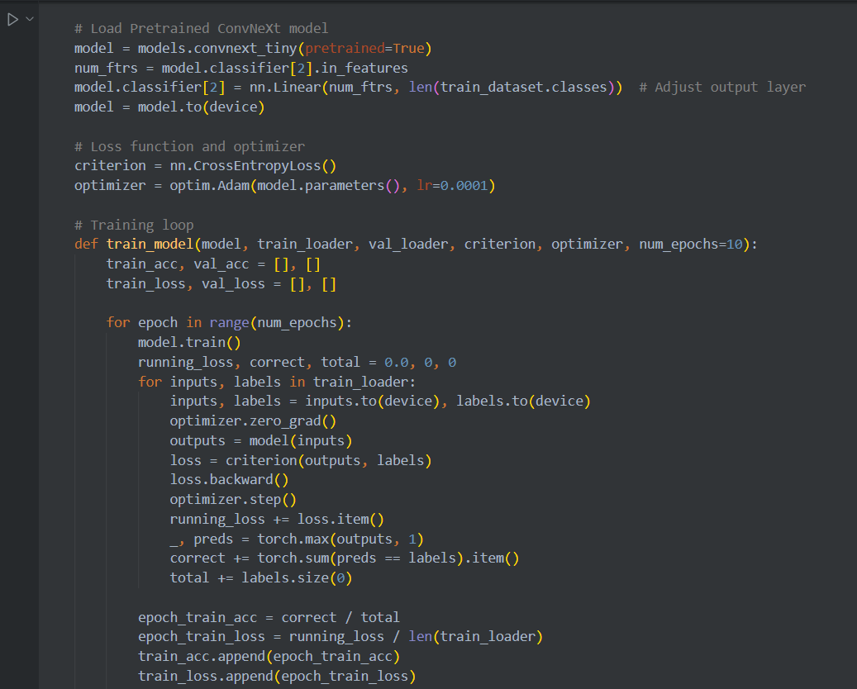
Module Implementation and Result

Slide 14
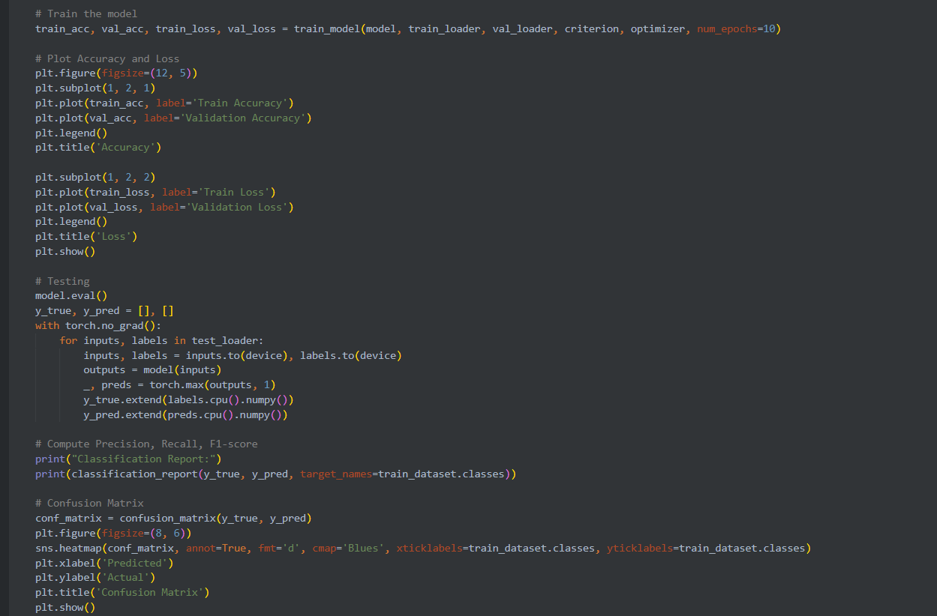

Slide 15
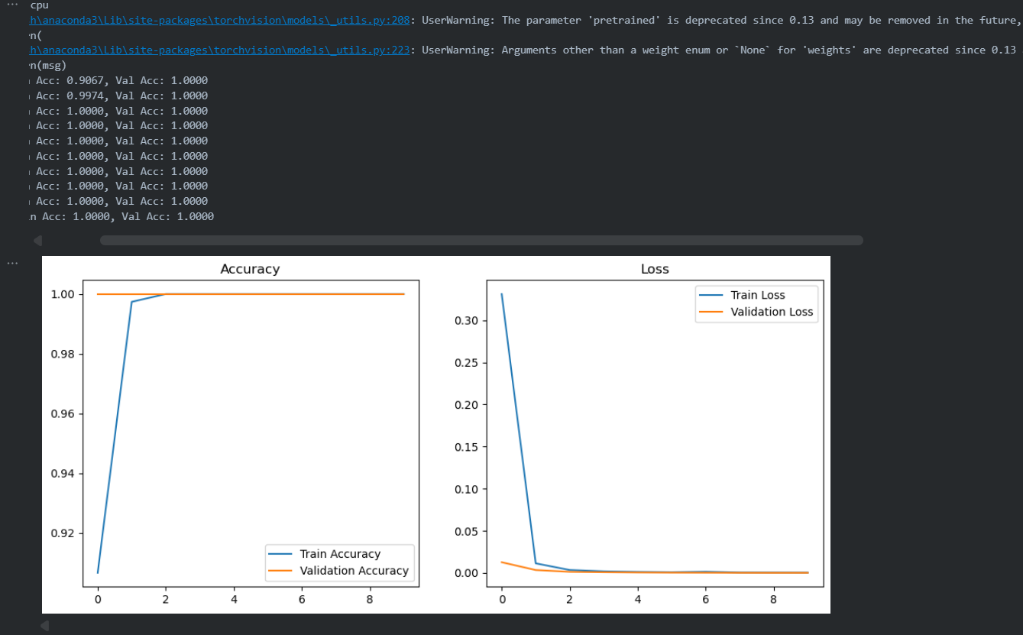

Slide 16
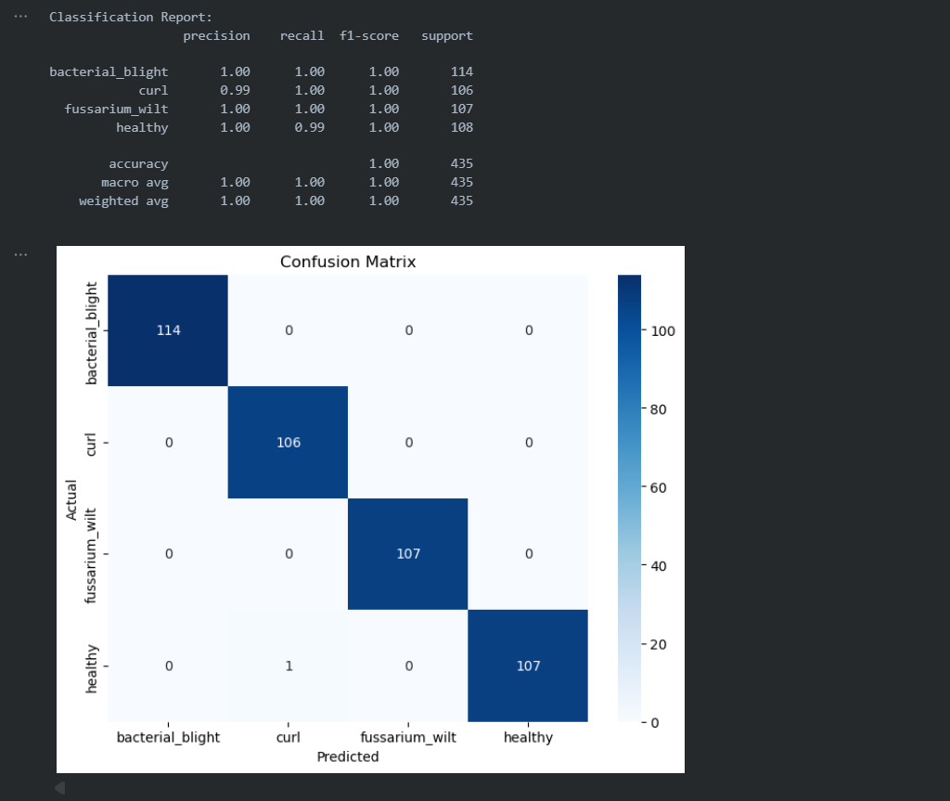

Slide 17
Results
Model Selected: ConvNeXt-Tiny (Pre-trained with Transfer Learning).
Overall Test Accuracy: Achieved 100.00% on the 'DATA' test set.
Weighted F1-Score: 1.00 (indicating perfect balance between Precision and Recall across all classes).
Class Performance: The model achieved near-perfect F1-scores for all four classes: Bacterial Blight, Curl Virus, Fusarium Wilt, and Healthy.
Comparative Insight: ConvNeXt outperformed other tested architectures (RegNet-Y and Xception) in generalizing to the cotton disease data.

Slide 18
References
ConvNeXt Architecture: Liu et al. (2022). A ConvNet for the 2020s. (The paper defining your key model.)
Transfer Learning: Yosinski et al. (2014). How transferable are features in deep neural networks?
Cotton Disease Detection (ConvNeXt focus): Tao et al. (2022). Cotton Disease Detection Based on ConvNeXt and Attention Mechanisms. (Use this to validate your choice).
Xception/Comparative Study: Islam et al. (2020). Deep Learning Approach for Predicting Cotton Leaf Diseases.
General CNNs: Krizhevsky et al. (2012). ImageNet Classification with Deep Convolutional Neural Networks.
Need for Severity: Patil and Patil (2021). Deep CNN Model for Cotton Disease Detection. (Mentions the need for quantification).
Advanced Detection: Zhang et al. (2023). Optimized YOLOv5 algorithm for small target detection in cotton wilt disease. (Reference for future object detection plans).

Slide 19
Thank You
Notes:
nhghggffghh

